Slide 1
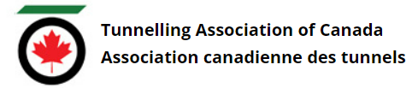
Tunnelling Association of Canada
Equity, Diversity, and Inclusion Moment
Diverse Holiday Celebrations

Slide 2
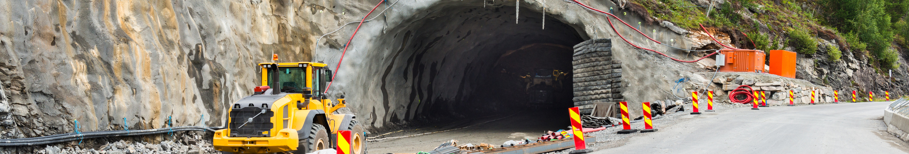
Tunnelling Association of Canada
Diverse Holiday Celebrations
Canada boasts diverse culture, and with that comes the celebration and observance of many different holidays meaningful to different cultures.
Those around you in the workplace may celebrate the same holidays as you or they may celebrate entirely different ones.
2

Slide 3
Tunnelling Association of Canada
Diverse Holidays and You
Increase your awareness of holidays others may be celebrating around you by consulting calendars that cover diverse holidays and keeping an open ear
Wish others happy holidays when they are celebrating, even if the holiday is not one you celebrate
Encourage resourcing and managing roles to be aware of diverse holidays when working on resourcing and approving time off
3

Slide 4
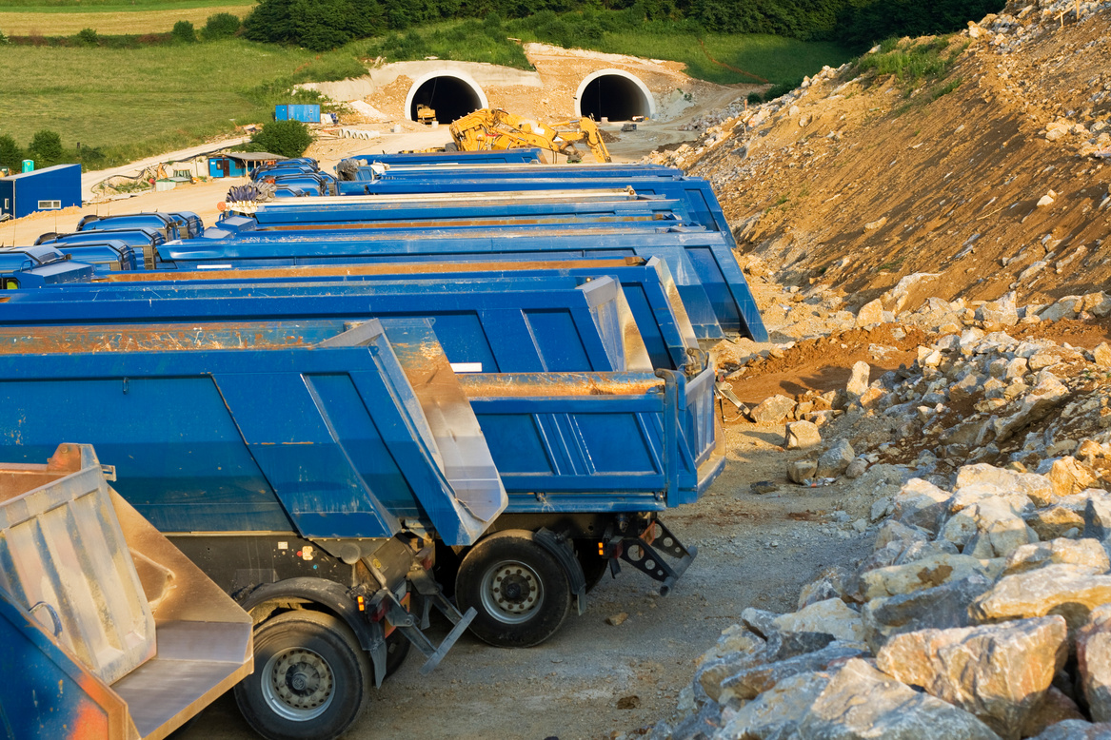
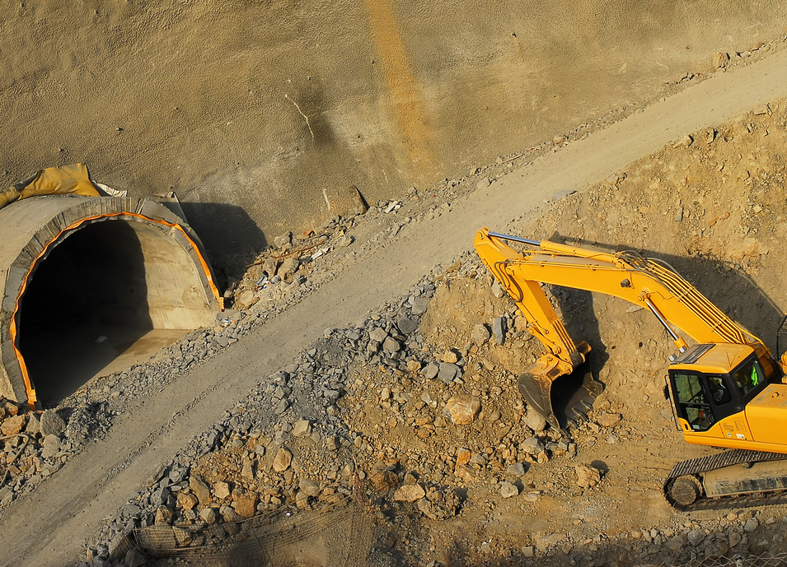
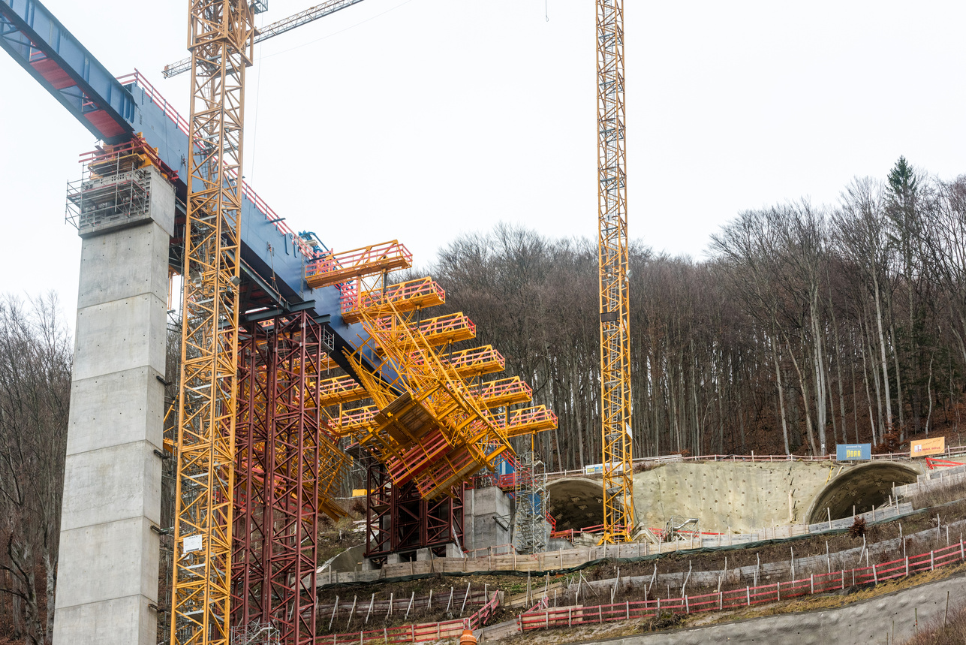
Tunnelling Association of Canada
Example
Ramadan is a holy month of fasting, introspection and prayer for Muslims, the followers of Islam. Fasting is typically observed from sunrise to sunset. Be mindful of this when planning events during Ramadan and consider this when staff are to undertake any strenuous work tasks.
4

Slide 5
Tunnelling Association of Canada
Thank you!
The End

